Slide 1
Notes:
Good morning everyone! Thank you all for attending the defense of my masters thesis,
which has been focused on quantifying consumptive water use in the State of Virginia.
Before beginning...
I’d love to acknowledge my committee, which is comprised of:
Dr. Julie Shortridge | Assistant Professor & Extension Specialist | Virginia Tech | Department of Biological Systems Engineering
Dr. Durelle Scott aka Scotty | Assistant Professor | Virginia Tech | Department of Biological Systems Engineering
Robert Burgholzer | Surface Water Modeler | Office of Water Supply | Virginia Department of Environmental Quality
Collectively (Transition)...

Slide 2



Water-Use Data and Research Program
Water Availability & Use Science Program
Water Use Data & Research Program
Office of
Water Supply
Provide assessment of the water resources of the U.S.
Support state water resource agencies in collecting and reporting water use data
Collects and analyzes state water use data. Directs water supply management and planning
Notes:
-My committee and this study are a part of a broader effort…
-with USGS’s Water-Use Data and Research Program, which
-aims to aid state water resource agencies to improve data retrieval, analysis, and exporting tools
-specifically associated with water withdrawals and consumptive use.
-Helps states provide more accurate estimates of water use to the USGS
-which assesses the water resources for the entire country every five years.
-Today I will be sharing the results of our data retrieval and analysis of water consumption in Virginia (Transition)...

Slide 3
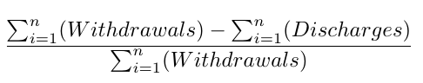
Overview/Outline
1
Urgency for Improved Water Supply Management
2
Consumption Studies
Withdrawals
Discharges
3
Research Objectives
4
Data Sources
Consumptive Water Use
5
Data Processing and Cleaning
6
Results
Spatial Analysis
Trend Analysis
Comparison to Literature
8
Conclusions
Notes:
This presentation starts by introducing the concept of…
why there an urgency to improve water supply management in a state that has historically been water plentiful
then how studies from climatically similar areas have approached quantifying consumptive use
then how I manipulated withdrawal and discharge data from different sources to estimate consumption
on the statewide, watershed, county, and facility level
-We will then wrap up with a trend analysis and a comparison of consumption found in literature
-with conclusions and suggestions for future work at the end.
-so without further ado, why do we care? (transition)...

Slide 4
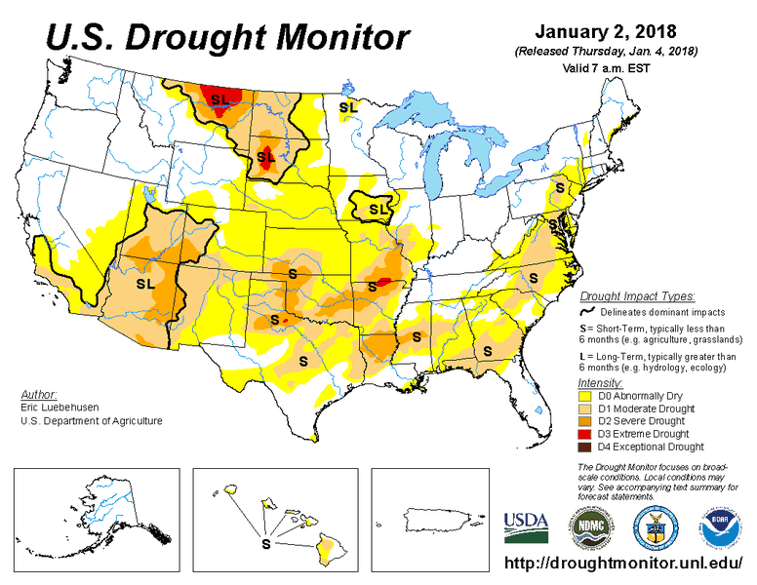
By 2071, nearly half of the freshwater basins in the US may not be able to meet the monthly water demand₁
Agriculture responsible for 80-90% of Nation’s Consumptive Use₂
Water scarcity will threaten industrial development
Energy Production accounts for 41% of Freshwater Withdrawals in US₂
Notes:
-In a study performed by the Rocky Mountain Research Station…
- It was estimated that nearly half of the 204 freshwater basins covering the United States may not be able to meet monthly water demand by 2071.
-water scarcity has been deemed one of the most pressing issues of the 21st century, and
-Reductions in water supply will not only impact human health and available habitat,
-but the growth and development in economic sector
-especially the agriculture and energy sectors which use the most water each year.
-Therefore, State Agencies need to adapt water supply management techniques
- in the face of increased demand and unstable water resources.
-Especially for states that have been historically water plentiful like Virginia…(transition)

Slide 5

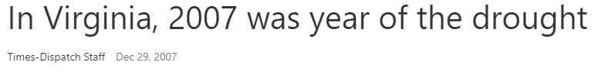
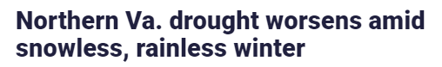
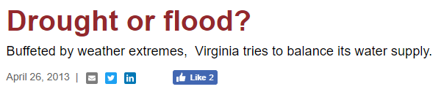
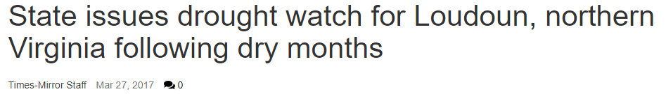
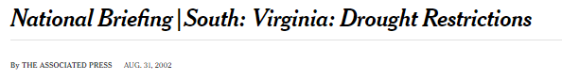
Droughts
Record low mean daily flow levels₃
Data Gaps
In ground and surface water withdrawal data collection₄
Urgency for Improved
Water Resource Modeling &
Management
Discrepancies
Between actual and predicted water supply demand between 2010-2015₄
Unknown
Impact of consumption on water supply₄
Notes:
-Specifically, VA has subtropical climate that benefits from
-Rainfall higher than the national average (43 inches - national average is 30.21 inches)
-But that hasn’t stopped multiple droughts from occurring throughout the years (click to reveal headlines)
-Leaving
-Record low flows
-widespread wildfire
-several public water systems on the brink of failure
- and restrictions on water use (less than 60 days of water supply capacity)
-this sparked a major shift in water management perception
-and influenced the creation of Virginia’s first State Water resources plan in 2015 (click) to protect and manage water resources to meet long-term human and environmental needs.
-the plan further identified that uneven data collection (click)
- discrepancies between actual and predicted water supply demand, (click)
- and a lack of knowledge of the stress consumption has on water supply (click)
-hinders the ability of water planners to effectively model water supply and manage our resources (click)
-This study suggests that obtaining a comprehensive knowledge of consumption (click) will help improve these efforts (Transition)...

Slide 6
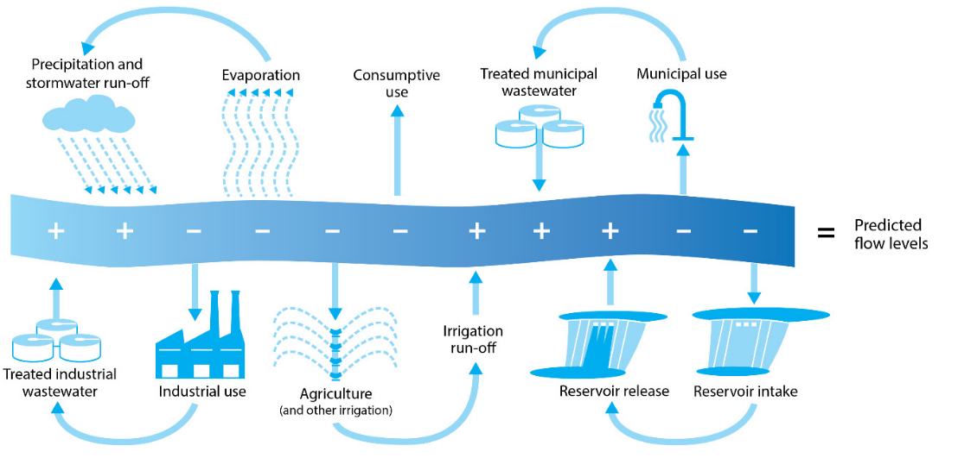
Consumptive Water Use Studies
Removal of water without returning to a water resource system₃
Net Water Use
Agriculture/Irrigation (75-100%₅)
Commercial
(5-10%₅)
Predicted Water Supply
0.8 MGD
1 MGD
Energy
(0.1-5%₅)
Industrial
(5-30%₅)
20%
Municipal
(10-40%₅)
Consumed
Source: JLARC₄
Notes:
-Consumptive water use is defined as water that is withdrawn from a water resource and not returned (reveal box around consumption)
-where loss occurs through evaporation, transpiration, conveyance losses, and incorporation in products and animals.
-It often gets confused with the phrase “water-use”,
-which only focuses on the gross volume of water withdrawn (point to withdrawals) to predict future supply and demand
-However, we can get a better idea of the actual stress withdrawals place on water sources,
- if we identify the net water that is first diverted from water sources (click and point),
-returned after use (point),
-and ultimately consumed (point)
-To get a better idea of consumption rates that would be comparable to Virginia, I referred to studies from climatically similar areas (click)
-Here is a summary of the 17 studies I examined, which primarily focused on consumption in the Agriculture/Irrigation, Commercial, Energy, Industrial, and Municipal sectors.
-where energy facilities consume the least amount of water, while agriculture is typically assumed to be completely consumptive due to lack of discharge data
-Essentially these studies gave me a good basis of the challenges that one faces during computing consumption,
-and also revealed distinct gaps to build off of, to give us a better knowledge of consumption throughout the state…(Transition)

Slide 7
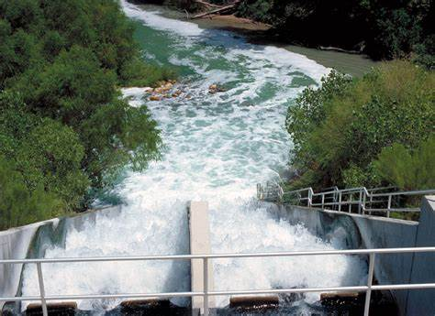
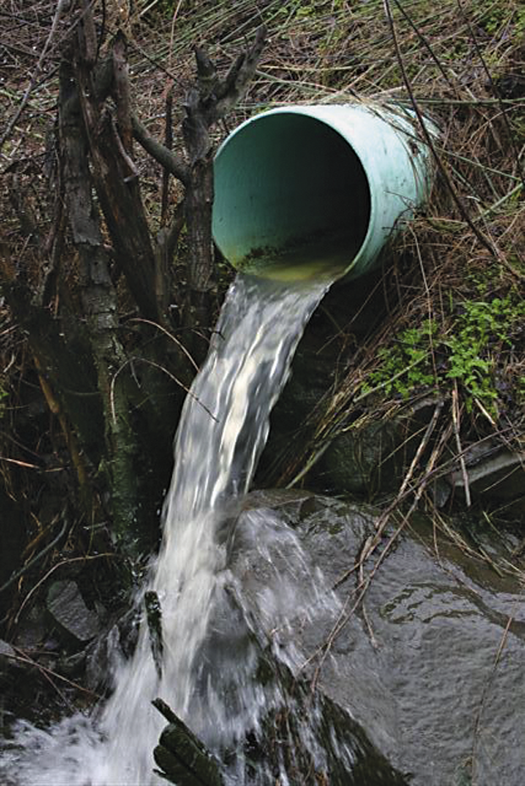



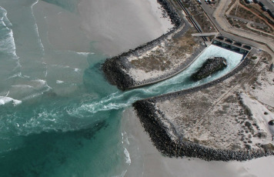


Gaps in Studies
Lack of methodology
Energy assumed to be non-consumptive
Classification of aquaculture
Narrow scope
Limited sectors
Notes:
-Specifically gaps included…
-A lack of methodology..(click)
where some studies used published literature values to estimate consumption for their respective study area.
This disregards the inherent variability consumption has through time and within sectors.
-I also saw energy facilities were often excluded from analysis…(click)
because they are assumed to be non-consumptive.
Even if it is so, some energy facilities can withdraw billions of gallons per day and any percentage of loss would be much more compared to minor water users.
-Aquaculture on the other hand was masked within analysis…
-by being grouped with agriculture or commercial operations, which display higher consumption rates than typical aquaculture facilities
-which have consumption rates more comparable to the energy sector
- Most studies were also limited in scope…
- Where few explored multiple spatial scales
-and multiple approaches to presenting consumption estimates
-And finally, most studies focused on singular water use sectors …
-which excludes valuable data that can be used to better characterize total water consumption for their study area.
-This study aims to address these gaps by leveraging monthly facility level withdrawal and discharge data from two different sources,
- to estimate water consumption across several spatial scales and water use sectors in Virginia
These estimates are then used to answer three research questions... (Transition)

Slide 8
Research Objectives
1
How do characterizations of consumptive use differ depending on water use sector and spatial scale?
2
Are there statistically significant trends in consumption through time and do they vary by water use sector?
How do consumptive coefficients from this study compare to climatically similar areas?
3
Notes:
First, how do characterizations of consumptive use differ depending on water use sector and spatial?
And what scale provide the most meaningful estimates?
Based on these estimations, are there statistically significant trends in consumption through time and do they vary by sector?
Are there any sectors that require more attention from the DEQ?
Then how do our estimates compare to published values from climatically similar areas?
And to answer these questions, let’s first look at our available data (transition)...

Slide 9

Data Sources
Withdrawals
Discharges
Agency
Virginia Water Withdrawal Permitting Program (VWP)
Reporting Program
Virginia Pollution Discharge Elimination System (VPDES) Program
Withdrawals > 10,000 gal/day₃
Agricultural Withdrawals > 1 Mgal/month₃
Any point source discharge₄
Reporting Requirements
Virginia Water Use
Data System (VWUDS)
Database
National Pollutant Discharge Elimination System (NPDES)
Notes:
Withdrawals
For the state of VA, withdrawals from surface and groundwater (click) are regulated
by the Department of Environmental Quality’s Office of Water Supply (or what I’ll refer to as the DEQ)
Data is self reported and regulated under the Virginia Water Withdrawal Permitting Program
Where reporting is only required for users exceeding 10,000 gallon per day
Or for any agricultural operation exceeding 1 millions in any given month.
These thresholds along with grandfathering clauses, exempt a vast majority of users from reporting or obtaining a permit (JLARC source 4)
Nevertheless, exempt users are encourage to report their monthly withdrawals
Which are submitted once a year to the Virginia Water Use Data System
This data is not publically available and was obtained through collaboration with the DEQ
Discharges
As for discharge data,
Section 402 of the Clean Water Act requires all point source discharges to obtain a National Pollutant Discharge Elimination System Permit (NPDES)
In Virginia, NPDES permits are issued by the DEQ (VPDES Program), while the Environmental Protection Agency (EPA) ultimately maintains authority.
Therefore discharge reports are available to the public in the EPA’s Enforcement and Compliance History Online System (ECHO).
Specifically under the NPDES database, which can be obtained through RESTful web services (click to transition)

Slide 10
Data Quality and Availability
Withdrawals
Discharges
Source
Lack data for half of exempt surface water users₄
More complete for active major (> 1 MGD) facilities
Completeness
1982-2016
Timeline
2010-Present
Water sector categorization
Source coordinates
Inconsistencies
Mislabeled outfalls
Water sector categorization
Reporting frequencies
Anomalous entries
Notes:
In terms of data availability and quality, both data sources have their caveats…
For our withdrawal data…(click)
We lack a good chunk data for users that fall below the reporting thresholds and prior grandfathering clauses
For users that do report, we have average monthly withdrawals (in MGM) from 1982-2016
Inevitable inconsistencies originate from self-reporting and include:
inconsistent categorization of facilities into water use sectors
And missing or incorrect coordinates at the point source level.
Despite these inconsistent attributes, the actual monthly withdrawal values have been thoroughly vetted by DEQ staff
Our discharge data on the other hand…
Is as-reported from Virginia’s NPDES program and represents a snapshot of the data as it existed during extraction
Therefore, data tends to be more complete for active and major facilities that discharge more than 1 MGD.
While the data flow for smaller facilities to the national database have only recently become a priority
Despite this, discharge monitoring reports are publically available for facilities in Virginia starting in 2010 (reveal)
Which narrows our comparison of consumption to 2010-2016
There are a lot more inconsistencies in the discharge data
Including the labeling of outfalls, which are the point sources for discharge from facilities
We found that internal and ms4 outfalls that track internal processes and stormwater were being labeled as external outfalls
Which overestimates return flow by orders of magnitude
We also found that ECHO classifies facilities as either industrial or municipal
Which limits the ability to estimate consumption over water use
And inconsistent reporting and anomalous entries were also encountered throughout this analysis
So, even though these two databases provide a potentially rich data source for characterizing water consumption, we can’t use the data directly from the sources.
Therefore, we pushed through the data with processing and cleaning methods (Transition)...

Slide 11
Data Cleaning
1,521 Flagged coordinates in VWUDS
Manually located with google maps
Weighted Decision Tree
If weighted flag ≥ 1→ Replace with median discharge
If weighted flag ≤ 1→ No change
Text Mining & Rule Based Classification
Sort into six major sectors based on Standard Industrial Codes and facility name
Flag Anomalous Discharge Entries
Identify External Outfalls
Missing/Incorrect Coordinates
Resolve Anomalies
Classify Water Use Sectors
Flagging Criteria
Median outfall discharge
Design flow
Domain Expertise
Outfalls ending in 001
Notes:
The first main step of data cleaning included…(click)
Locating missing/incorrect coordinates in the withdrawal database with the use of google maps
I then automated the process for flagging anomalous discharge values (click)
based on exceeding median outfall discharge and design flow
Flagged entries were then replaced with its median outfall discharge for the given year based on a weighted decision tree
The most important steps were then identifying external outfalls and classifying water use sectors for facilities
Where domain expertise from the DEQ was required to identify typical notation for external outfalls
and case studies for major facilities in VA were explored.
water use sectors were then assigned using a rule based classification approach based on standard industrial codes and facility name into six main sectors, which I will demonstrate on the next slide…(transition)

Slide 12
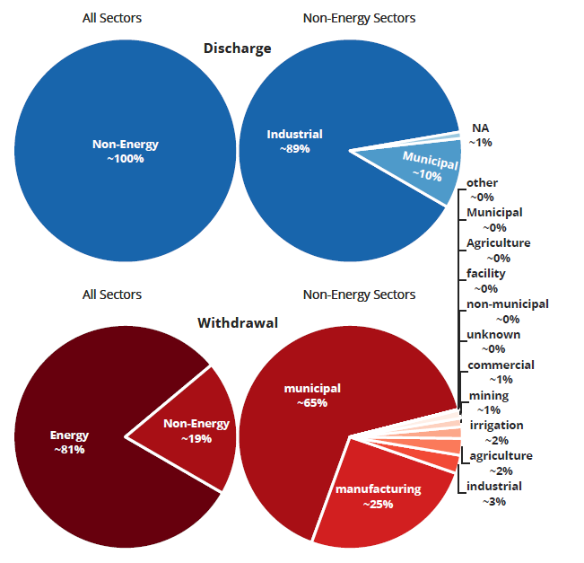
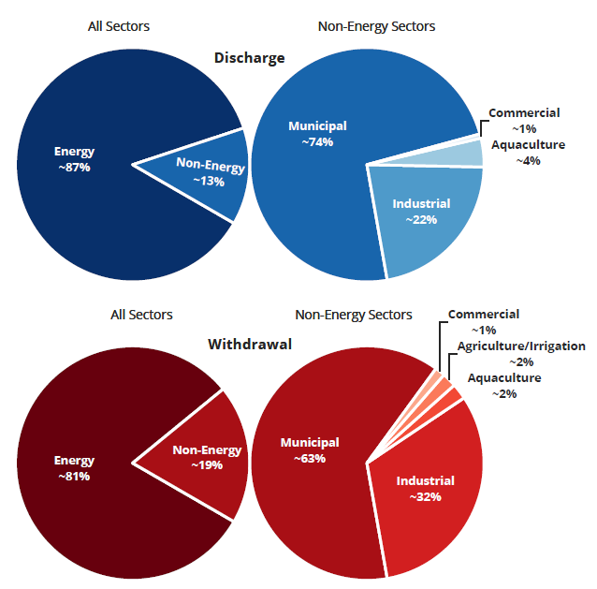
Water Use Sector Classification
Before
After
Notes:
Before classification…
-Discharge facilities were classified as either industrial or municipal, where this figure shows the distribution of median annual reported discharge per sector
-through my classification methods, I was able to classify these facilities into energy, municipal, industrial, aquaculture, and commercial.
-where there are no discharge records for agriculture.
-i’d like to note here, that the discharges that were classified as industrial before, were actually from energy facilities (click to reveal box), and that the municipal sector reports the most discharge per year for the non-energy sectors.
Now for our withdrawal data…
We see the effect of inconsistent classification, with the multitude of non-energy sectors here (click)
But with the classification method, we get distributions of median annual withdrawals that are comparable to our discharges
Which allows us to estimate consumption over water use and makes matching facilities between our data sources easier…(transition)

Slide 13
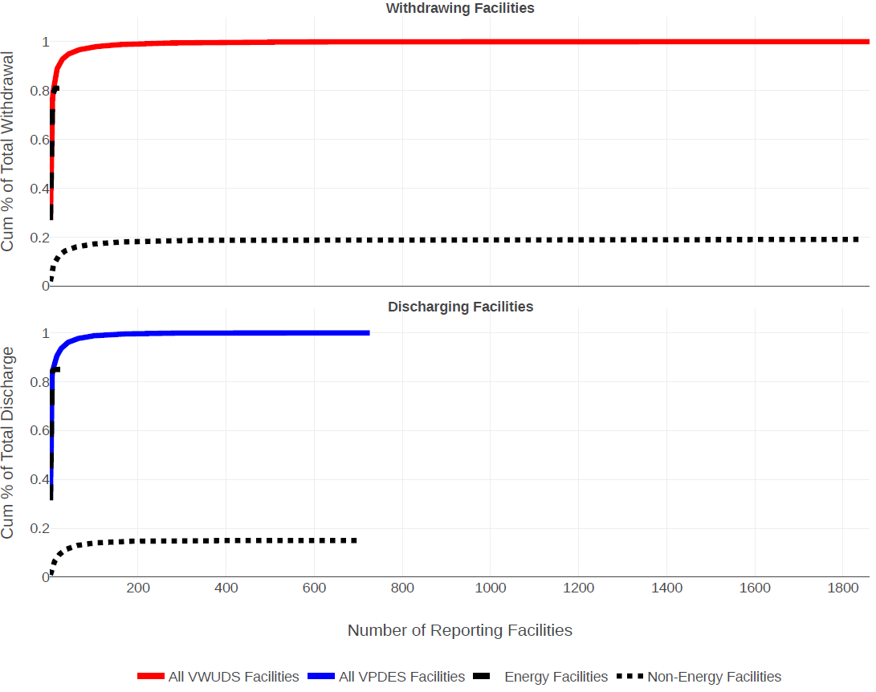
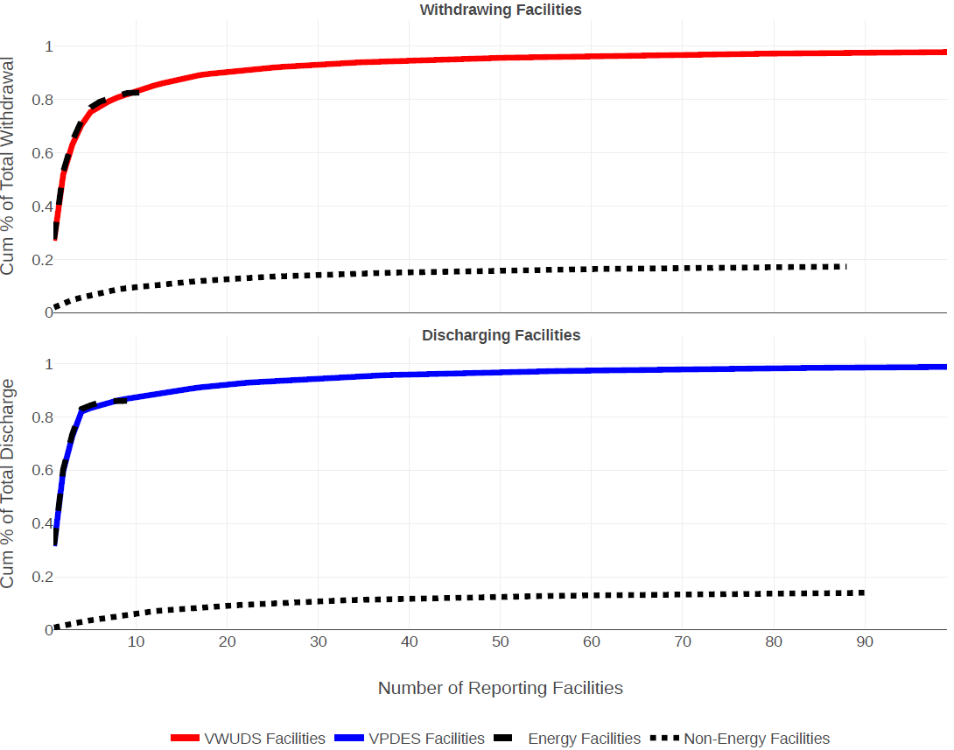
Matching Facilities
Why Match?
Unequal number of reporting facilities
Small number of facilities responsible for majority of water withdrawn and discharged
Notes:
Under ideal conditions, there would be a one-to-one match for every discharge entry and withdrawal entry.
However, the difference in regulations and reporting between the sources hinders that.
And we see that in this figure to the left
Which shows the average cumulative percentage of total reported withdrawal (on top) and discharge (on bottom) vs the number of energy facilities and non-energy facilities responsible for the total volume.
This reveals a couple of key features
First that there is an unequal number of reporting facilities between our withdrawal and discharge data sources
Which may be explained by the agricultural withdrawals will not have associated discharge records and discharge for minor facilities may not be represented in ECHO
Despite this, it also shows a small number of facilities are responsible for the majority of the water that is withdrawn and discharged each year in the state (click)
So let’s zoom in to the top 100 facilities (click)
This shows us that if we can at least match these major facilities, we can perform consumption analysis on the facility level and get a clearer idea of consumption through our other aggregation techniques...(transition)

Slide 14

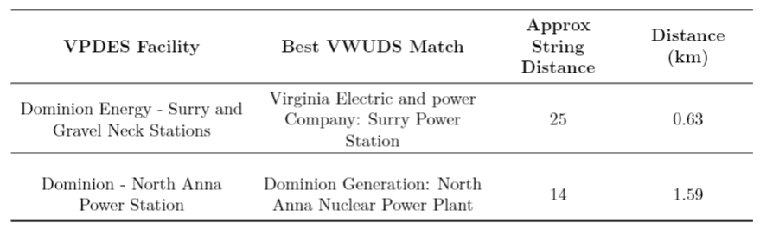
Facility Matching Mechanism
Municipal &
Agriculture
Calculate distance between facilities
Apply distance threshold
Calculate string distance between names
Locate Best Match Based on Distance and String Distance
Weighted average number of insertions, deletions, and substitutions needed for names to match
1
2
3
4
Notes:
Therefore I created a matching mechanism based on distance (click and click) and facility name (click) to narrow potential matches between the two data sources...
Where difference in facility name is quantified as an approximate string distance, which estimates the average number of insertions, deletions, and substitutions needed for the names to be exact matches.
In the end, the best suitable match is then selected as the facility with the lowest approximate string distance and physical distance (click)
Below is an example of the two nuclear facilities in Virginia.
Here we see some limitations to my approach.
Mainly that facility names can differ significantly between the two databases (click) and the accuracy of facility coordinates can vary.
Other limitations are extended to municipal and agricultural facilities (click)
Where it’s challenging to estimate consumption on the municipal facility level due to
Unaccounted for use
Differing customer bases and transfers
Processing water
Which leads to unequal withdrawals and discharges
This creates a noisy relationship and led us to exclude public suppliers and wastewater treatment facilities from our matching mechanism
Along with the municipal sector, agricultural operations do not have associated discharge records, therefore excluding them from the matching mechanism
Regardless of the limitations, I was able to push through and match over 100 facilities across virginia…(Transition)

Slide 15
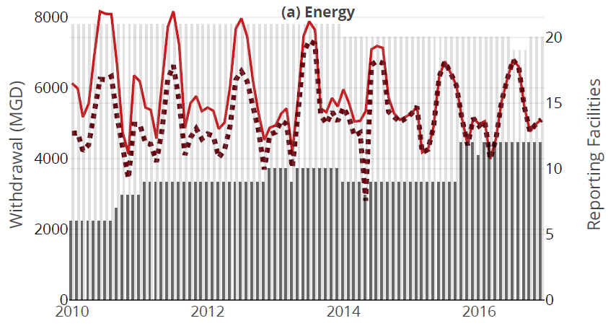
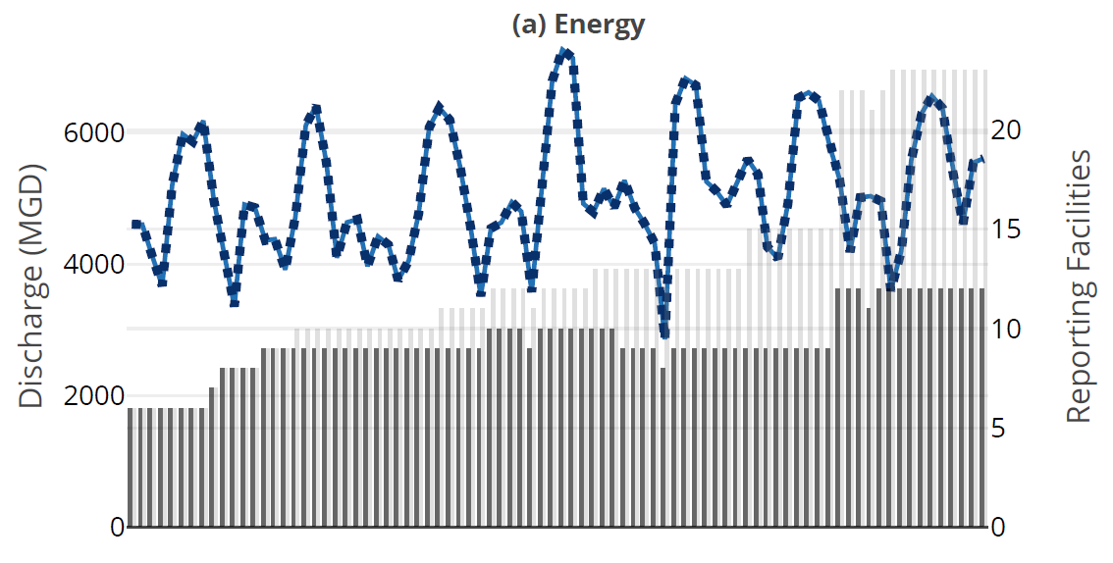
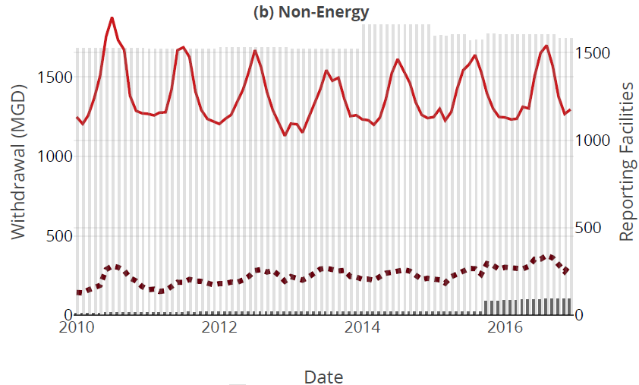
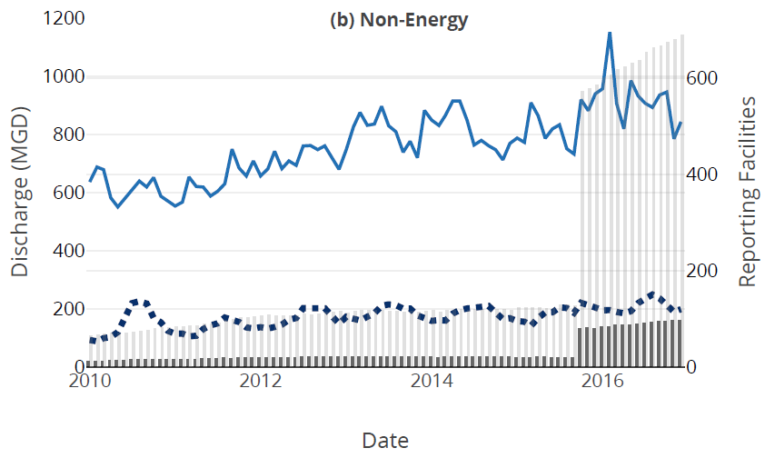
Results of Facility Matching
Not all withdrawing facilities have associated discharge entries found in ECHO
12 matched energy facilities
Discharge reporting becomes more comprehensive after 2015
111 matched non-energy facilities
Captured ~81% and ~89% of total reported withdrawal discharge, respectively.
Notes:
-Specifically, for our withdrawals, I was able to capture 91% of energy withdrawals and 19% of the non-energy on average
-where we have monthly withdrawals from matched facilities in this dashed line and total withdrawal in the solid line
-where the bars on the secondary y-axis then show the number
-of total reporting facilities in light grey
-and number of matched facilities in this darker grey.
-even though it looks like I wasn’t able to capture a lot of the non-energy withdrawal,
-it is a product of excluding municipal and agricultural facilities from our matching mechanism
-I have results for our other major non-energy sectors, but for the sake of time,
-I will present everything in energy vs. non-energy for the majority of this presentation.
-Now if we move on to our discharge data (click), i was able to capture 99.9% of energy discharge and 23% of the non-energy on average
-where we see 12 energy facilities 111 non-energy facilities matched between the two sources (click)
-now this highlights a couple of key insights…
-first that I was able to capture almost all of the reported energy discharge obtained from ECHO
-but that is not reflected in our withdrawal data (click)
This suggests that discharge records for those remaining energy withdrawals are
(a) not being reported to the state or
(b) are reported to the state database but are inconsistently reported or flowed into the national database
We also see again the clear difference in the sheer number of reporting withdrawing facilities vs. discharging facilities (click)
Which further suggests not all withdrawal entries have an associated discharge entry located in ECHO
These figures also highlight an increase in the number reporting facilities in ECHO past October of 2015 (click)
Which is likely a result of a reporting rule set by the EPA in 2015 in efforts to improve shared information for all discharging facilities,
rather than prioritizing large facilities
The increase makes a difference in the total amount of reported discharge,
but not as much from our matched facilities.
And regardless of inconsistent reporting, we have been able to match about 81% of total withdrawals and 89% of total discharge (click)...
we means we can still push through and make some meaningful inferences of consumption throughout the state…(Transition)

Slide 16
Results
Objective 1
Statewide Consumption
Total Volume Approach
Energy & Non-Energy
Obj 1: How do characterizations of consumptive use differ by sector and scale?
Notes:
Which is where we enter our first research question...
Where we are going to look at monthly statewide consumption for our energy and non-energy sectors using a total volume approach (Transition)

Slide 17
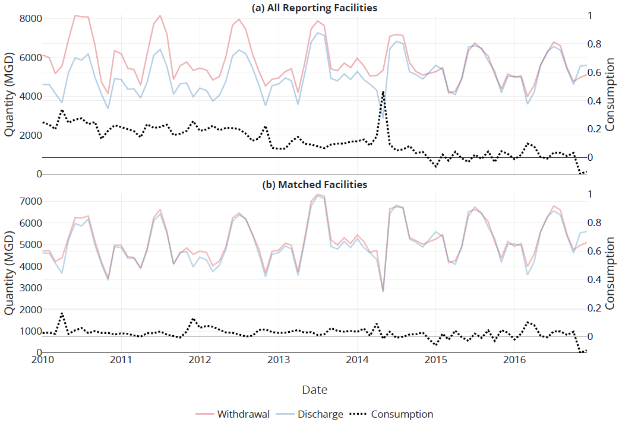
Statewide energy consumption calculated with total volume approach
Statewide Energy Consumption
All Data
4-20%
Matched Data
0.4-4%
Notes:
-Here we have monthly reported withdrawals in red, discharges in blue, and the of fraction of water not returned to water sources in black from 2010-2016…
-If we consider all of our available data, we may say energy consumption ranges from 4-20% throughout the state on average.
-with a decrease over time
-However, when we just focus on matched facilities with linked withdrawal and discharge entries, that range decreases to 0.4-4%
-with more persistent consumption over time
-Both scenarios show occurrences of negative consumption, which suggests either facility level error in reporting or purchases from public suppliers.
- I investigated this concept by splitting the energy sector into their respective power type to show how larger facilities steer the main trends of consumption when we aggregate reported total volume per month,
-but I won’t share the results for the sake of time. But if you have questions at the end, I’m more than happy to answer them
For now, let’s look at our non-energy sectors..(transition)

Slide 18
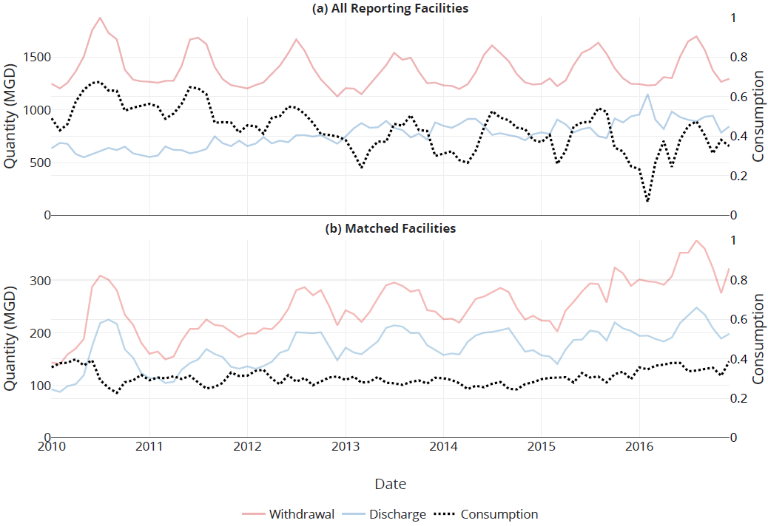
Statewide non-energy consumption calculated with total volume approach
Statewide Non-Energy Consumption
All Data
37-51%
Matched Data
28-33%
Notes:
Here we almost see seasonal variations in consumption if we consider all of our available non-energy data…
And we say non-energy consumption typically ranges between 37-51%
Once again, this range is significantly lowered to 28-33% when we focus on matched facilities.
And we recognize this only captures total reported withdrawal and discharge from our matched commercial, industrial, and aquaculture facilities...
But we can see consumption is persistent, if not slightly increasing after 2015.
And now that we have seen what consumption looks like on a coarse level, let’s dive into the finer spatial scales (Transition)...

Slide 19
Results
Objective 1
Watershed and County Consumption
Total Volume Approach
Non-Energy Sectors
Obj 1: How do characterizations of consumptive use differ by sector and scale?
Notes:
Where we refine our focus into a watershed and county aggregtaion...
And I’ll present on results from our non-energy sectors ...(Transition)

Slide 20
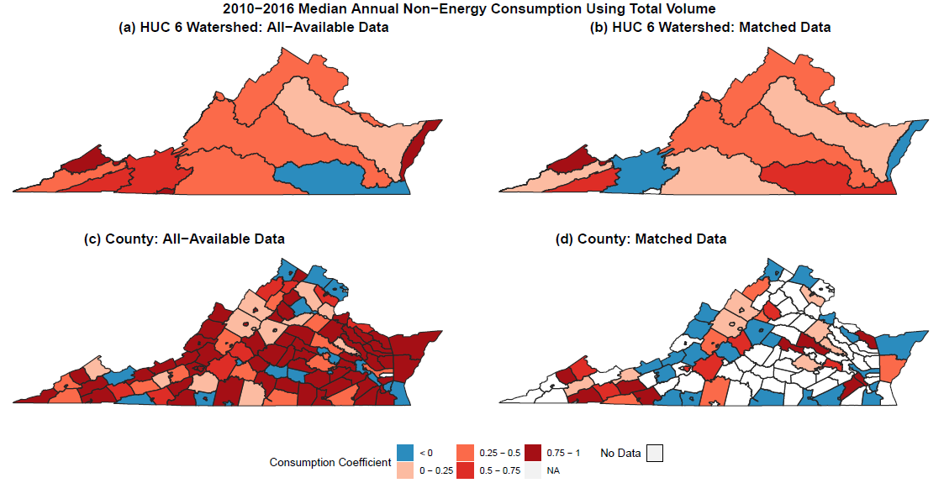
Errors that were masked at coarser scales are now revealed
Notes:
-Here we see median annual consumption for non-energy sector in HUC 6 watersheds and counties for all available data on the left and matched on the right
-this ultimately shows us that errors that were masked or balanced out on the statewide level are revealed at finer spatial scales.
-which are most noticeable as the negative consumptive watersheds and counties here
-a couple explanations here include purchases from public suppliers which are not included in the data gathered from VWUDS, resulting in excess discharge
- input error
-or discharge reporting inconsistencies, which are most noticeable as the higher consumption watersheds and counties
-when we move from all available data to just matched, we see a lot more negative consumption observations,
-but know that the potential errors are independent of each other, because facilities report their own data with their own equipment
-Now that we’ve seen a refined spatial aggregation, let’s move down even smaller to the facility level…(Transition)

Slide 21
Results
Objective 1
Facility Level Consumption
Median Facility Approach
Energy & Non-Energy
Obj 1: How do characterizations of consumptive use differ by sector and scale?
Notes:
Where here, only the distributions of matched data are considered to compute consumption per facility…(Transition)

Slide 22
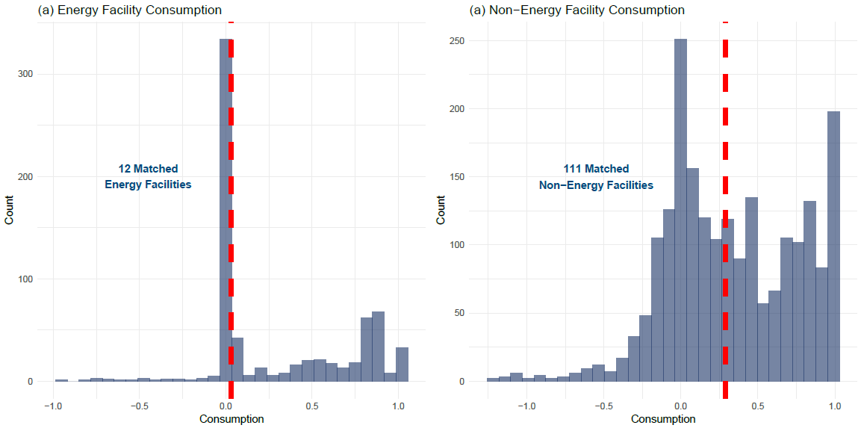
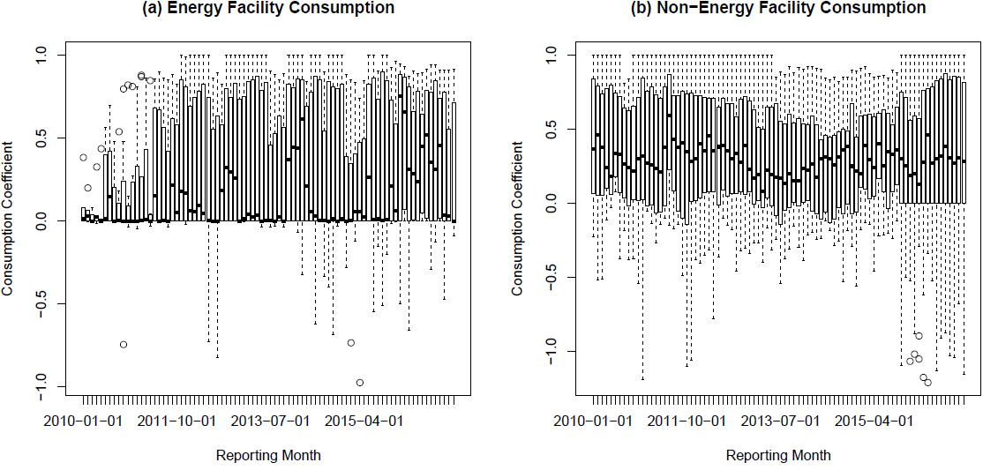
Facility Level Analysis
Distribution of Reported Consumption Across Facilities
IQR of Consumption
Facility Level
Energy
0.1-0.4%
Non-Energy
28-32%
Statewide
Energy
0.4-4.0%
Non-Energy
28-33%
Energy
0.04-77%
Non-Energy
0.0-71%
Notes:
-Here we start with the temporal distribution of reported consumption across facilities over time
-where we see high variation and large ranges of reported consumption (click)
-which isn’t surprising due to the data quality of smaller facilities
- But if we are to get rid of that temporal aspect and focus on the frequency of facility level reported consumption between 2010-2016 (click),
-we see asymmetrical distributions of facility consumption, with skewing to the left for both energy and non-energy facilities
-with high frequencies near 0, and more diverse consumption among the non-energy facilities
-and if we look at median annual estimates, we get consumption estimates similar to the statewide approach (click)
- The advantage and disadvantage of this approach is removing the bias from large facilities
-removing the bias shows us the variability across facilities and highlights errors that are ultimately masked in the coarser scale
-but two facilities reporting a 50% consumption rates impact water supply completely different
if one is withdrawing 1 MGD while the other withdrawals 100 MGD.
Regardless, this approach added to our comprehensive knowledge of consumption in Virginia...(Transition)

Slide 23
Spatial Consumption Conclusions
Statewide Analysis
Large facilities influence consumption estimates
Ranges of consumption lower when only fully matched facilities are considered
Discharge data reporting has become more comprehensive since October of 2015
Watershed and County Analysis
Errors are revealed at finer spatial scales
Errors are independent of each other
Facility Level Analysis
Consumption reported by facility varies within its respective sector
Obj 1: How do characterizations of consumptive use differ by sector and scale?
Notes:
Which wraps up our first objective of characterizing consumption over spatial scale and sector…
-And I’ll summarize the main findings before moving onto our next two objectives.
First I talked about consumption on a statewide level with a total volume approach (click)
This showed us that larger facilities dominate the trends (click)
Matching facilities significantly reduces the range of consumption values
And that discharge data has become more comprehensive since 2015
We then refined our scale to the watershed and county levels (click)
This revealed errors that were most likely canceled out at the statewide scale
And that errors are independent of each other
We finally refined down to the lowest possible scale and looked at consumption across facilities (click)
Which told us that consumption varies across facilities within the same sector
Now knowing all of this, are there trends in our consumption observations over time? (transition)...

Slide 24
Results
Objective 2
Trend Analysis
Mann Kendall Approach
Obj 2: Are there statistically significant trends in consumption through time?
Notes:
To do this, I applied Mann Kendall trend tests to our statewide monthly consumption observations...(transitions)

Slide 25
Mann Kendall
Detects general increasing or decreasing trends in environmental time series data
Non-parametric test designed to decrease type 1 error
Tests performed on statewide monthly consumption observations
Looped over all available data and matched data
Notes:
Mann Kendall detects general increasing or decreasing trends in monthly environmental data while decreasing the type 1 error
Which is when a significant trend is identified when one actually isn’t present
The non-parametric test was applied to our statewide estimates and was looped over all available data and matched facility data
Where I’ll present results with a tau and p-value (transition) (Transition)

Slide 26
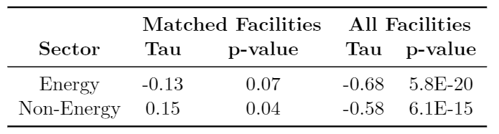
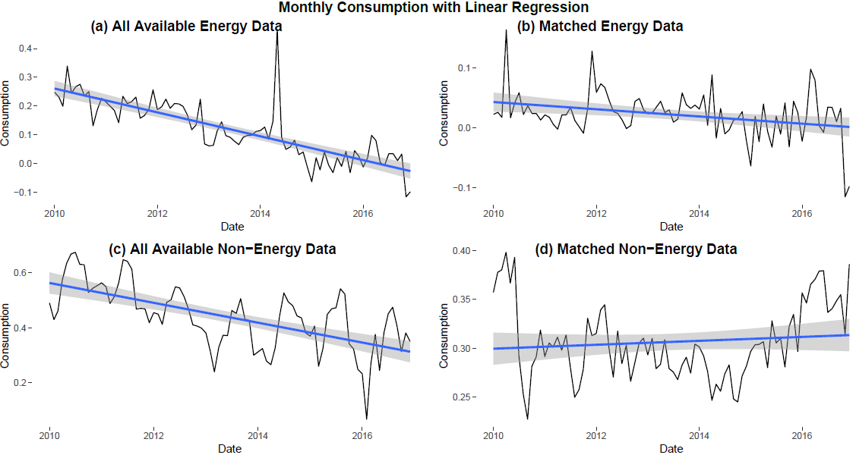
Mann Kendall
Monthly Statewide Consumption with Linear Regression
Inconsistent reporting affects consumption trends
Matching withdrawal and discharge records is important
Notes:
Here we have plots of statewide monthly consumption in black with a linear regression in blue considering all available data
And from this, it appears that there is a significant downward trend in consumption over time (click)…
But if we focus on just matched facility data, that trend neutralizes (click and click)
Where energy consumption has a downward trend and is not significant
And non-energy consumption shows a barely significant upward trend
This suggests that inconsistent reporting (click) affects our perception of consumption trends, making it difficult to say if a trend truly exists
And that matching withdrawal entries to their associated discharge entry is critical when examining trends through time.

Slide 27
Results
Objective 3
Comparison to Literature
Climatically Similar Areas
Median Annual Estimates
Commercial, Energy, Industrial, and Municipal Sectors
Obj 3: How do consumption values for Virginia compare to climatically similar studies?
Notes:
Even though we can’t determine if trends are truly significant through time, we can still take our estimates and compare them to published literature values to provide some validation…
Where I will present results from some non-energy sectors we haven’t seen separated yet...(transition)

Slide 28
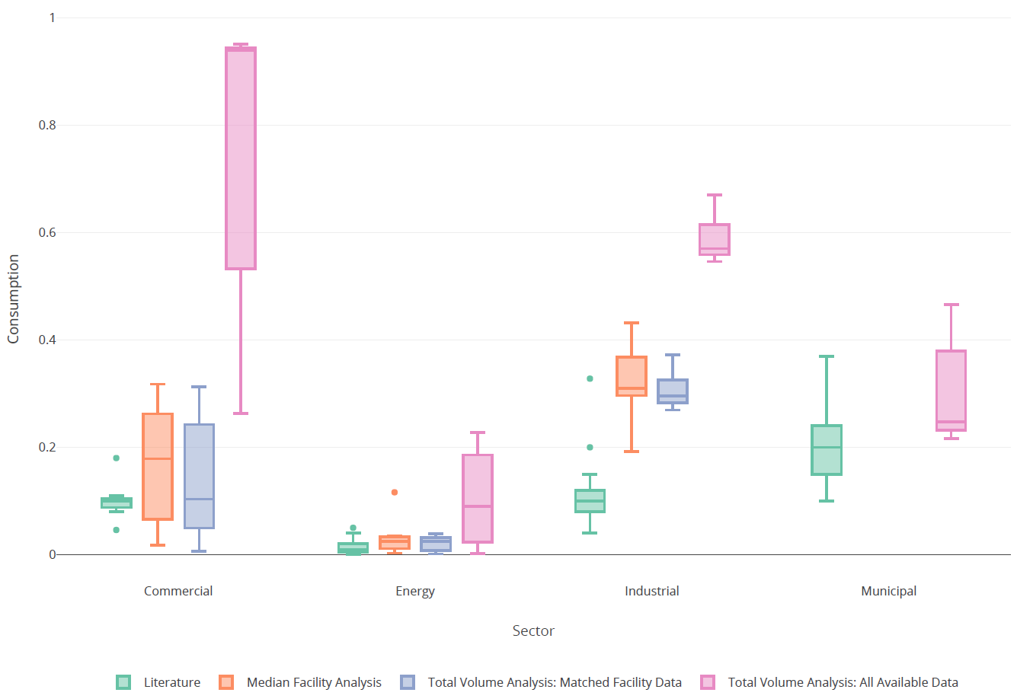
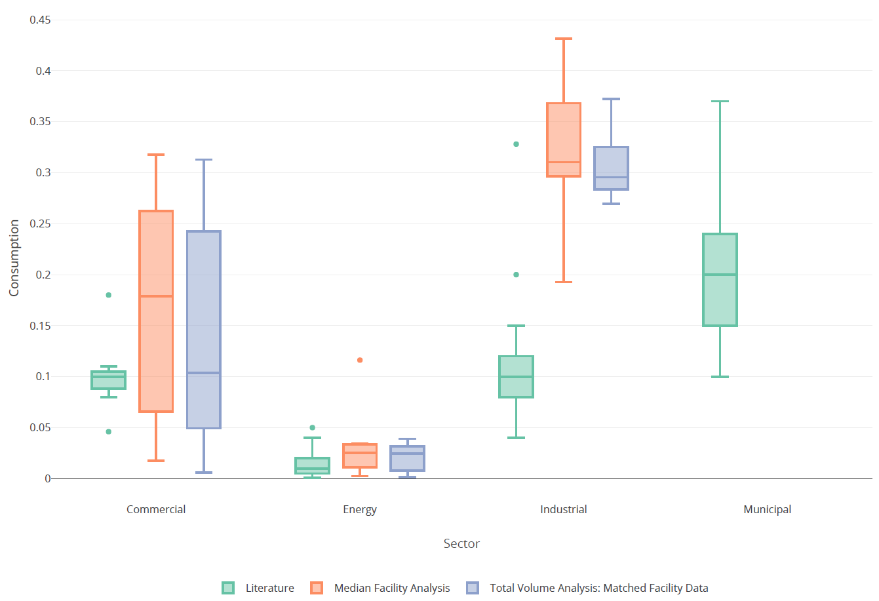
Comparison of median annual consumption estimates to literature
All available data reports higher consumption than matched data
Facility level and total volume approaches provide similar ranges of median annual consumption
Industrial consumption higher than what literature suggests
Notes:
Here, we see the comparison of median annual values from literature (green), to facility level results (in orange), and statewide total volume results for our matched data (in blue) and all available data (in pink)
-for commercial, energy, industrial, and municipal sectors
-this further proves that all available data reports higher consumption than matched data and is influenced by inconsistent discharge reporting before 2015 (click)
-we also see overlapping ranges of annual municipal consumption, which we thought was interesting due to its noisy facility level relationship
But if we just focus on just matched data results…(click)
-we see that the ranges of median annual consumption are pretty much spot on between the facility level and statewide approach (click)
-where we assumed that ranges for the facility level approach would be much larger compared to the total volume approach.
-they did on a monthly basis, but not as an annual value
-we also see that industrial consumption in Virginia may be higher than what literature suggests (click)
-this may be indicative of the industry located within the commonwealth
- as paper mills and mining operations are among the more consumptive industrial processes.

Slide 29
Conclusions
Objectives 1,2,&3
Key Insights
Suggestion for Improvement
Policy & Management Applications
Obj 3: How do consumption values for Virginia compare to climatically similar studies?
Notes:
And now here comes the big so what and why? What key findings can we take from this study? And how can we build off of this research and apply it to water policy and management in the state…(transition)

Slide 30
Conclusions
Obj. 1: How do characterizations of consumptive use differ depending on water use sector and spatial scale?
Inconsistent reporting affects estimates of consumption through time
Consumption varies widely across facilities within the same sector
Facility level errors are canceled out at coarser spatial scales
In Virginia, energy consumption is typically between 0.4-4% and Non-Energy consumption is between 28-33%
Obj. 2: Are there statistically significant trends in consumption through time and do they vary by water use sector?
Inconsistent reporting makes it difficult to tell if trends truly exist
Trends of matched facilities suggest consumption is persistent and slightly increasing
Obj. 3: How do consumptive coefficients from this study compare to climatically similar areas?
Industrial consumption in Virginia is higher than what literature suggests.
Notes:
From the first objective, we looked at consumption on a statewide level, watershed and county level, and facility level for energy and non-energy sectors…(click)
-this showed us that reporting of discharge from the state to the EPA has become more comprehensive through time (click)
-but the inconsistent reporting before 2015 affected estimates of consumption
-we also saw consumption varies across facilities within the same sector
-and any errors for those facilities are ultimately balanced out in coarser spatial scales
-and most importantly, we can say energy and non-energy consumption are between 0.4-4% and 28-33%, respectively.
Our second objective then asked if our consumption observations had any general increasing or decreasing trends over time…(click)
-which showed us that inconsistent reporting makes it hard to tell if trends truly exist
-and if they do, we need to look at comprehensive matched facility data, which appeared to be persistent through time and slightly increasing in non-energy
We then compared our estimates to literature values…(click)
saw industrial facilities may be consuming more water than what literature suggests

Slide 31
Future Work
Suggestions for Improvement
Match more facilities between data sources
Use transfer and delivery data to reduce noise
Spatial analysis with listed attributes rather than coordinates
Policy & Management Applications
Establish clearer reporting information
Target segments for additional reporting and analysis
Clarifying exact locations of point withdrawals and discharges
Review and improve local water demand estimates and incorporate consumption
Notes:
WIth everything said and done, of course I have several recommendations for how to improve this research (click)...
First, confidence in consumption estimates would increase if we match more withdrawals to their associated discharge records
Locating transfer and delivery data for facilities that are self supplied and also purchase water from suppliers would also be amazing to see if facility level noise gets reduced.
I also believe that spatial analysis with the data we have could be performed using listed attributes, rather than relying on the self reported coordinates
And as for policy and management applications...
The first could be to establish clearer reporting requirements and information for both sources
Which used to clarify to minor users that reporting withdrawals will not alter the status of existing exemptions
Or perhaps impose civil penalties to major water users that do not report their use in compliance with reporting
I also believe identifying stream river and stream segments at greatest risk for water shortages
-and making efforts to collect more data and perform analysis near them would be a good logical next step in research expansion
Along with this, clarifying exact coordinates of point withdrawals and discharges
-will increase the accuracy of spatial aggregation
But most importantly, consumptive water use can be used as an input in the several modeling scenarios the DEQ performs
- which will quantify the actual stress withdrawals place on water resources.
-And having more robust models of water supply will be the basis to help set policy priorities and allocate resources among the commonwealth, to make sure that it remains a water plentiful state for years to come

Slide 32








Acknowledgements
Rob
Committee
Joey Kleiner and Drew Hammond at VDEQ
Old Friends
New Friends
Mom
Notes:
And with that, I thank you for your time and I’d love to acknowledge the wonderful people that got me here.
-First to my committee and Joey Kleiner from the DEQ who have graciously survived long bi weekly calls and my presentations with hundreds of slides
-I would have never been able to navigate the mess that is self reported data without you
-then of course to the old and new friends who have been there for every happy hour and sad hour over the past two years
-and of course the biggest acknowledge to my mom who always picks up the phone and never asks questions

Slide 33
Questions?
Code Repository Available on GitHub

Slide 34
References
[1] Brown, T. C., Mahat, V., Ramirez, J. A. (2019). Adaptation to Future Water Shortages in the United States Caused by Population Growth and Climate Change. Earth’s Future. https://doi.org/10.1029/2018EF001091
[2] Goldstein, R. (2013). Evaluating Thermoelectric, Agricultural, and Municipal Water Consumption in a National Water Resources Framework. Palo Alto. https://doi.org/3002001154
[3] Paylor, D. (2018). Status of Virginia’s Water Resources: A Report on Virginia’s Water Resources Management Activities (2018). Richmond.
[4] Greer, H. (2017). Effectiveness of Virginia ’ s Water Resource Planning and Management. Richmond.
[5] Shaffer, K. H., Runkle, D. L. (2007). Consumptive Water-Use Coefficients for the Great Lakes Basin and climatically similar areas, 191.

Slide 35
Supplementary Slides

Slide 36
Background

Slide 37
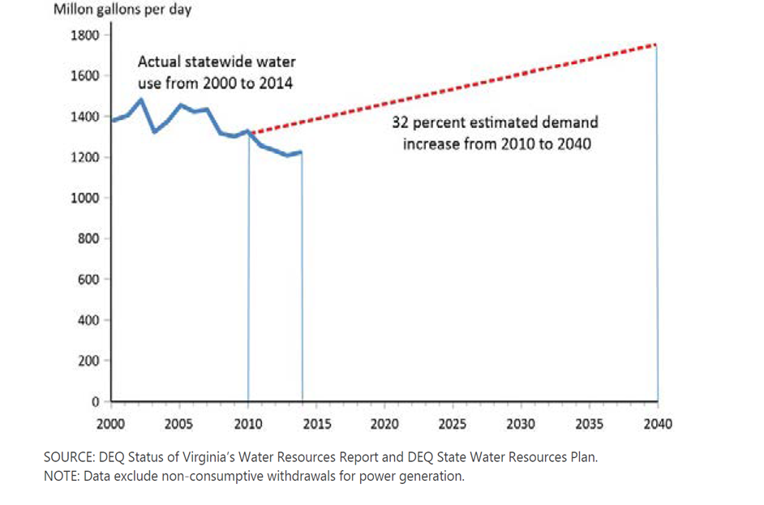

Slide 38
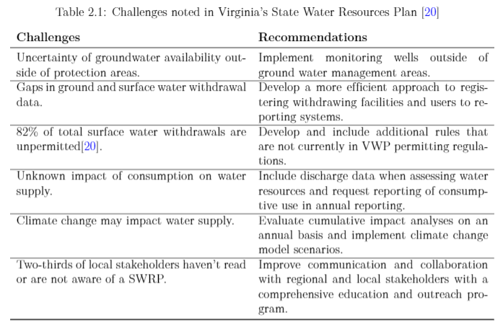
Water Resources of Virginia

Slide 39
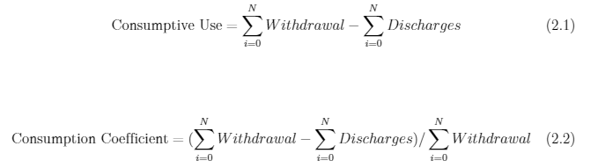
Consumptive Water Use
Currently, there is not a universally accepted method to estimate consumptive water use. Two common methods include tracking water from when it's withdrawn to when (or if) it's discharged into open waters (equations 2.1 and 2.2), or by applying consumption coefficients from climatically similar areas to estimated water withdrawals. Often times, the availability and quality of water use data differs significantly by jurisdiction and time. Monthly withdrawals and discharges for major power generation, industrial, public supply, and other metered sites are readily available for analysis, whereas data are typically scarce for minor users (< 300,000 gal/mon).

Slide 40
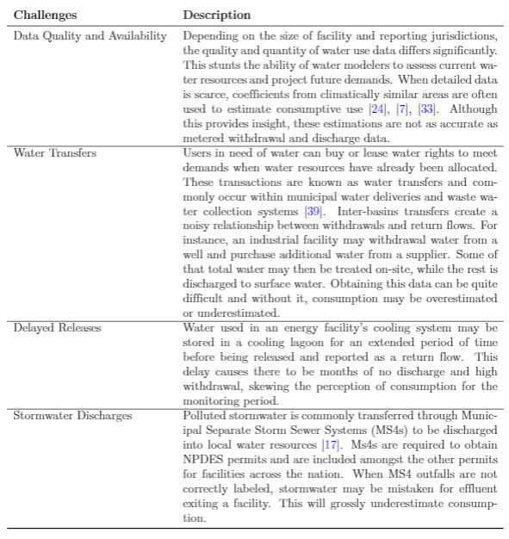
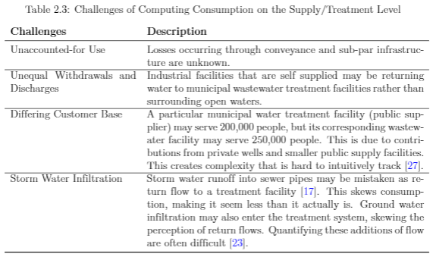
Challenges of Computing Consumptive Water Use

Slide 41
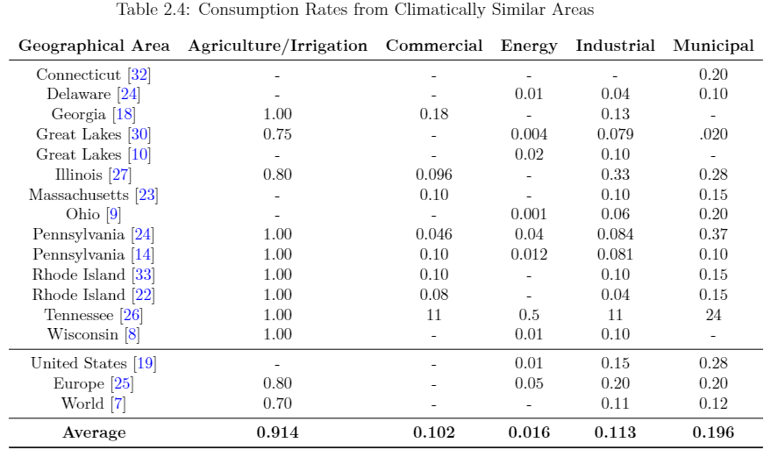
Studies from Climatically Similar Areas

Slide 42
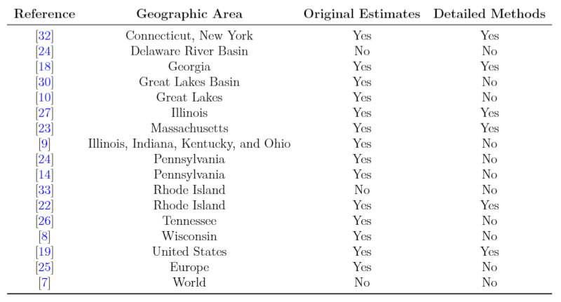
Studies from Climatically Similar Areas

Slide 43
Discharge and Withdrawal

Slide 44
Discharge Data: Virginia Pollution Discharge Elimination System
Scripts:
-ECHO_Timeseries.R
-ECHO_QAQC.R

Slide 45
ECHO Rest Services
ECHO Rest Services
800,000 regulated facilities with 299 possible attributes
Facility Search - Water
1,937 regulated Facilities in VA
Associated Permit Record: 142
General Permit Covered Facility: 313
Individual IU Permit: 1
NPDES IP: 1,143
Unpermitted Facility: 338
Effluent Chart
Flow, in conduit or thru treatment plant parameter (50050)
Monthly Averages (MK)
Notes:
New tool: https://echo.epa.gov/tools/web-services/loading-tool

Slide 46
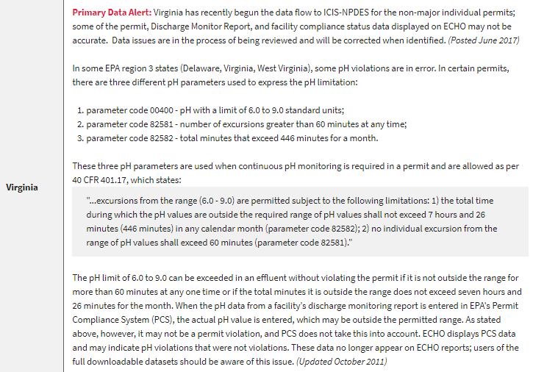
Known Data Problems in ECHO
Data Completeness:
-More complete data for active, “major” permittees
-Inspections for smaller CWA facilities may only be tracked in a state’s database and not reflected in national database
-time period of displayed data can vary
-data before 2000 has not been assessed
-data before 2010 is refreshed annually and not available for a lot of states
Notes:
https://echo.epa.gov/resources/echo-data/about-the-data#completeness

Slide 47
Summary of QA/QC Methods: Discharge Data
Seven Facilities
~Additional 45 MGD per year from 2015-2016
External: 1,077
Internal: 20
Internal Sum: 1
279 duplicate DMR entries
Differing Reporting Frequencies
Anomalous Discharge Quantities
Classification of Water Use Sector
Duplicate DMR Entries
Hydropower Facilities
Mislabeled Outfalls
Annual: 237
Semi-Annual: 361
Quarterly: 908
Monthly: 24,343
Flagging Criteria
> 100 * Median Outfall Discharge
> 1M * Median Outfall Discharge
> Design Flow
Design Flow = 0
Weighted Decision Tree
If weighted flag ≥ 1→ Replace with Median Discharge
If weighted flag ≤ 1→ No Change
Industrial: 199 Facilities
Municipal: 509
NA: 35

Slide 48
Duplicate DMR Entries
There are cases where facilities enter discharge quantities twice for an outfall for the same monitoring period. This leads to double counting of flow and skews estimates of consumption.
Duplicate entries are checked for in the ECHO_Timeseries.R script, right after being pulled from ECHO.

Slide 49
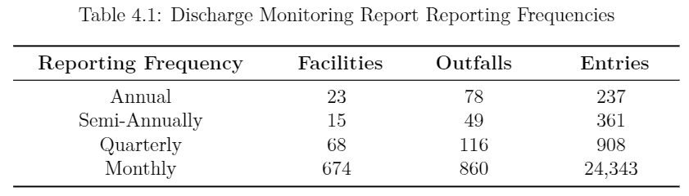
Differing Reporting Frequencies
Most facilities report discharges on a monthly basis; however, there are instances of facilities reporting once, twice, and four times out of the year. A single DMR is submitted for the monitoring period and represents a monthly average. Therefore, discharge for the individual months within the monitoring period are not represented. This underestimates facility discharge for the given reporting period.
A function was created to take the singular annual, semi-annual, and quarterly submissions and split them into individual DMRs to represent the monthly average for the given reporting period.

Slide 50
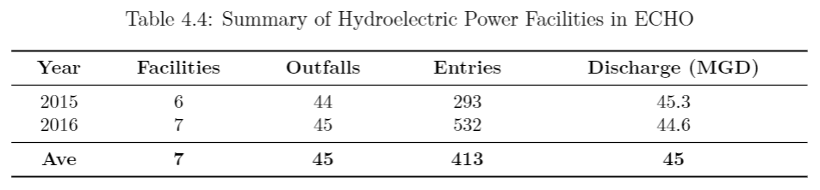
Hydroelectric Facilities
Water utilized for hydropower is considered to be nearly non-consumptive. Hydropower facilities have been removed from the VWUDS data set due to a change in reporting requirements, but discharges are still found within the ECHO system. This adds an overwhelming quantity of discharge to statewide estimates without matching withdrawals to balance it out.
Hydropower facilities with individual NPDES permits were removed from analysis

Slide 51
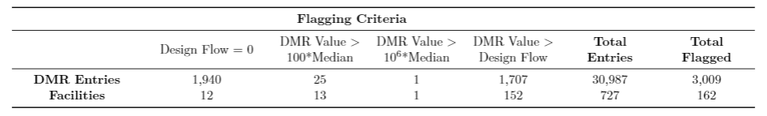
Flagging Anomalous Entries
DMR entries are flagged based on four criteria:
If the facility reports a design flow of 0
If the DMR entry exceeds 100*median outfall discharge for a given year
If the DMR entry exceeds 10⁶* median outfall discharge for a given year
If the DMR entry exceeds the facility’s design flow (if df > 0)

Slide 52
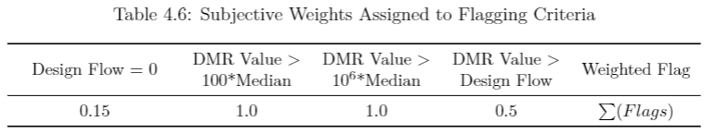
Flagging Anomalous Entries
Some flags lead to an increase in Type 1 error (detecting an anomaly when it’s not actually there). Why is that? Exceeding design flow proved to not be a good indicator. North Anna reports a design flow of 0.0 MGD. While this is an indication that design flow reporting for the facility should be examined, it is not a good enough indicator to determine if a discharge entry is erroneous. How do we combat this? Let’s assign weights to each flag

Slide 53
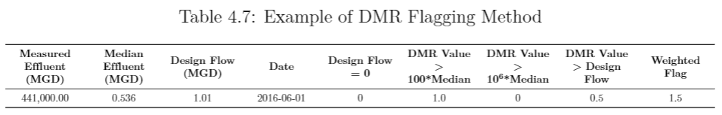
Flagging Anomalous Entries
If a discharge entry has multiple flags, like Dominion Terminal Associates LLP, each flag is assigned a binary value of 1. The weights from the previous Table are applied to each binary value and summed in a weighted sum column. This continuous attribute is then used to split the flagged entries into two classes: high concern and low concern. If the weighted flag value is greater than or equal to 1, it is labeled as high concern. Otherwise, it is labeled as a low concern. As a result, the entry below is marked as anomalous.

Slide 54
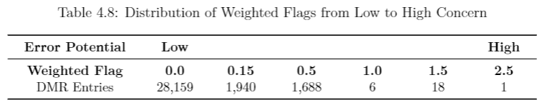
Flagging Anomalous Entries
Of the 30,987 discharge entries, 3,009 were flagged, and 25 were labeled as a high concern and replaced with its median outfall discharge. The remaining flagged entries, labeled as low concerns, were left intact. This small percentage of low concerns flags is due to misleading design flows provided by VPDES permits. Some design flows underestimate facility's actual maximum capacities, so when a measured effluent exceeds this limit (even by a minor amount), it is flagged.
No flags

Slide 55
Discharge Data: Outfalls
The Clean Water Act parameter code 50050 allows for users to query for flow, in conduit or through a treatment plant in ECHO. A multitude of other parameter codes related to flow exist in the system, but 50050 returns the greatest number of DMRs for the facilities located in Virginia. Because this parameter includes flow through facilities, there is a presence of additional outfalls that track more than the water leaving a facility and entering open waters. Other than external outfalls, internal and MS4 outfalls track internal processes and storm water flows, respectively.
Internal outfalls are often identified to ensure tracking of effluent concentrations that may be diluted at the final external outfall. This ultimately causes a surplus of discharge if not identified and removed from analysis. Unfortunately, accurate labels of outfalls are not represented in ECHO, as a result of being an as-reported data system. Consequently, the default type for outfalls in the Effluent Chart REST service, is external (1,078 out of 1,098).
Outfall IDs with leading zeros (e.g. 001, 002, 003...) are typically representative of external outfalls, while outfalls leading with other positive integers (e.g. 101, 102, 103, etc.) represent the internal outfalls leading to the final external outfall. HOWEVER, there are facilities that designate their 001 outfall to outfall to tracking storm water associated with a regulated industrial activity.
Rule of Thumb Created: Outfall 001 is representative of total flow leaving a facility
After filtering outfalls ending in 001, it’s apparent that:
Several facilities do not have an outfall labeled as 001.
There are facilities that have multiple external outfalls.
Some external outfalls include tracking flows from other internal outfalls or stormwater

Slide 56
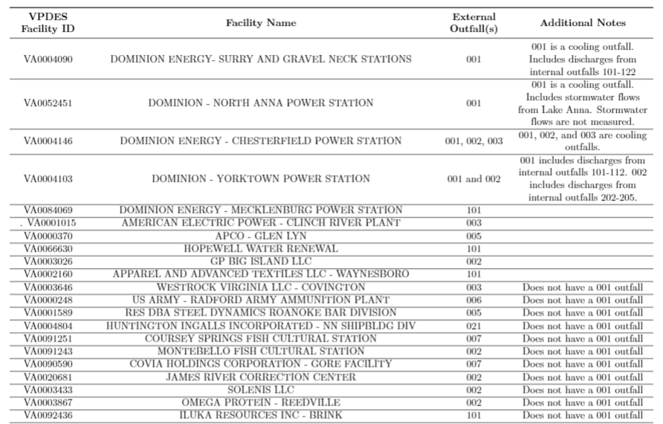
Outfalls that Don’t Fit 001 Rule
Facilities that don’t fit the 001 rule of thumb were handled on a case by case basis with extra input from Drew Hammond in the Office of VPDES Permitting

Slide 57
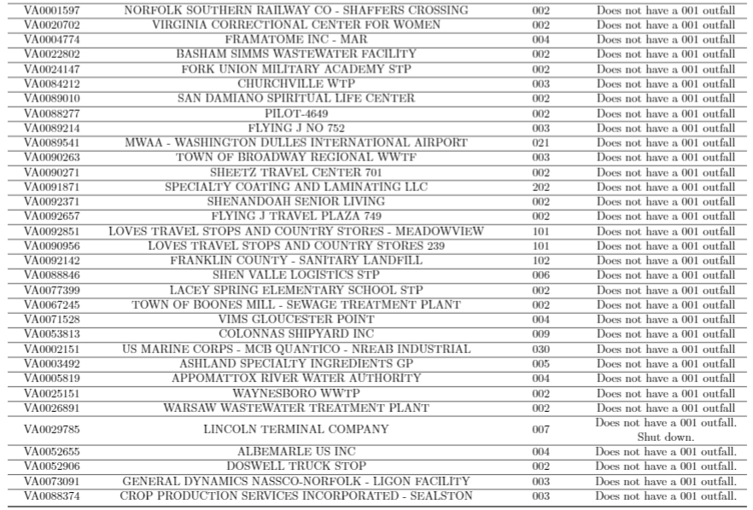
Discharge Data: Outfalls that Don’t Fit 001 Rule

Slide 58
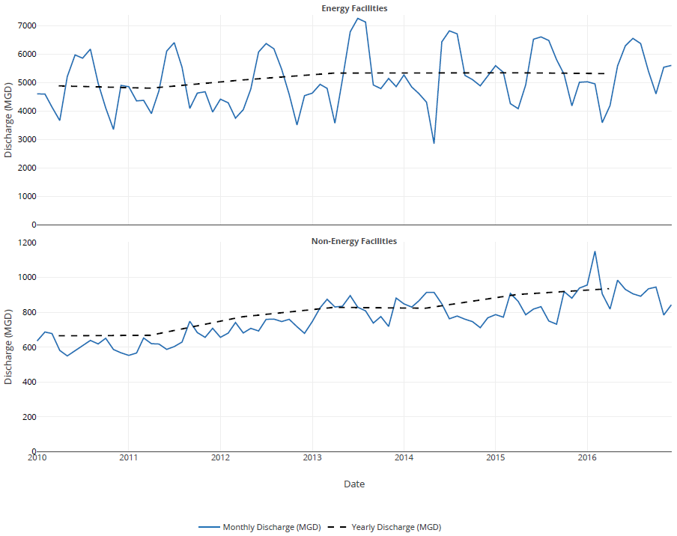
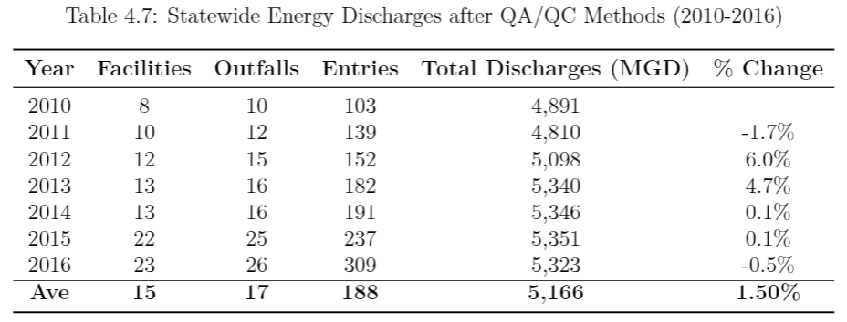
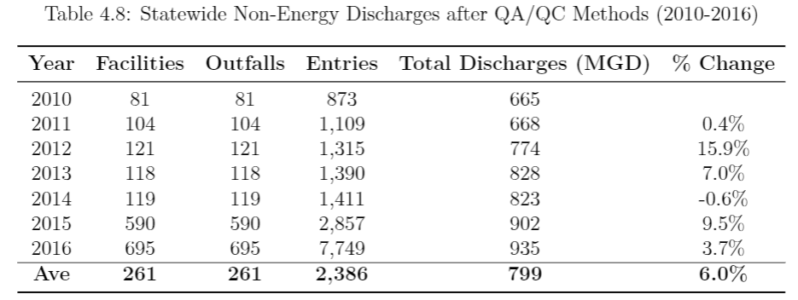
Statewide Discharge post QA/QC

Slide 59
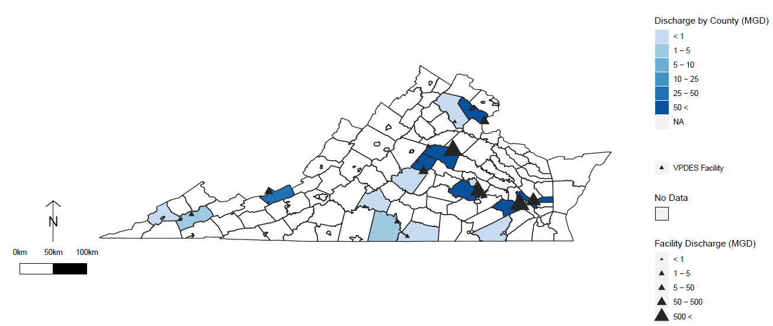
VPDES Energy Facility Locations with Median 2010-2016 Discharge

Slide 60
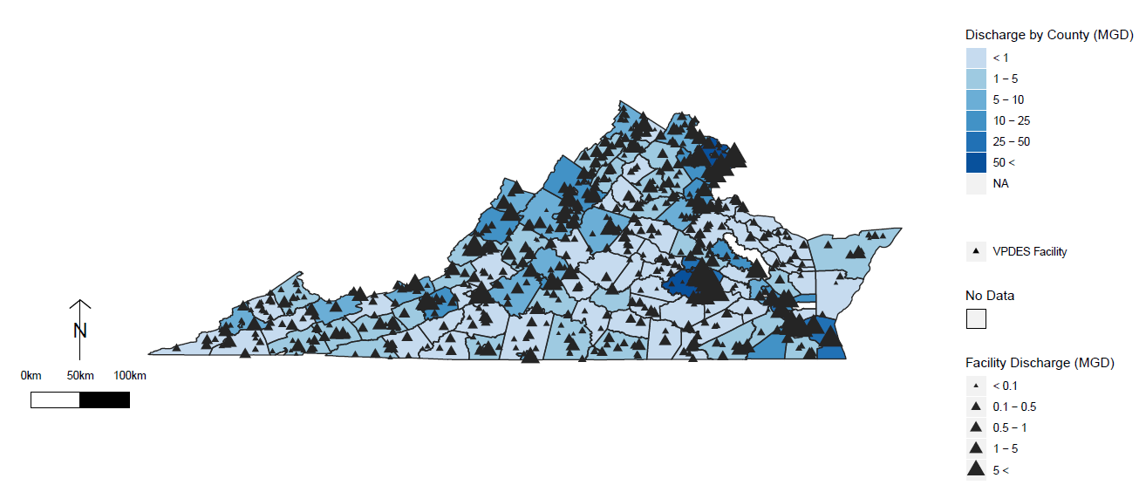
VPDES Non-Energy Facility Locations with Median 2010-2016 Discharge

Slide 61


Slide 62


Slide 63


Slide 64


Slide 65


Virginia Wateruse Database System (VWUDS)
On average from 2010-2016, approx 98% of reported water withdrawals come from surface water sources annually.
Notes:
(Withdrawals July 1, 1989 - had an existing withdrawal between 1989 and 2007 and have complied with regulations - received a 401 certification)

Slide 66


Virginia Wateruse Database System (VWUDS)

Slide 67

Comparison to VDEQ Reports
VDEQ Reported Values
Year | Total Withdrawals MGD | Error
2010 | 7,621 | 2.28%
2011 | 7,559 | 1.85%
2012 | 7,100 | 2.07%
2013 | 7,047 | 2.11%
2014 | 6,984 | 2.52%
2015 | 6,558 | 3.05%
2016 | 6,613 | 1.97%

Slide 68

Withdrawal Data: Missing/Incorrect Coordinates
Link to Manual Changes to Source Coordinates

Slide 69

VWUDS Energy Facility Locations with Median 2010-2016 Withdrawal

Slide 70

VWUDS Non-Energy Facility Locations with Median 2010-2016 Withdrawal

Slide 71


Slide 72


Slide 73


Slide 74


Slide 75
Methods

Slide 76
Need for Classification
The self-reporting nature of withdrawal and discharge data, as well as different reporting requirements, causes a disconnect in the classification of facilities into water use sectors. Specifically, all facilities in ECHO were categorized as either Industrial (27%), Municipal (68%), or NA (5%). This general classification associates energy producing facilities with industrial facilities. The classification of facilities in the withdrawal data (VWUDS) includes 13 different sectors (see Figure \ref{fig:bc}). Therefore, a semi-supervised learning approach involving text mining and rule-based classification was used to sort unlabeled facilities into one of six water sectors: Agriculture/Irrigation, Aquaculture, Commercial, Energy, Industrial, or Municipal.

Slide 77
Classification
4. Estimate Classification Error
Compare Rule-Based Classifications (Testing Set) to Training Set
SIC Codes
Use SIC Codes to Initially Classify Unknown VPDES Records
Decrease Training Error
Sector Classification Process
3. Create Rules for Classification
Use Frequent Terms for Each Sector as Rules
2. Find Frequent Terms
Use Known VWUDS Records as Training Set

Slide 78


Water Use Sector Classification
4. Estimate Classification Error
Compare Rule-Based Classifications (Testing Set) to Training Set
Standard Industrial Codes
Use SIC Codes to Initially Classify Unknown VPDES Records
40-49
Transportation & Public Utilities
Decrease Training Error
Sector Classification Process
2. Find Frequent Terms
Use Known VWUDS Records as Training Set
3. Create Rules for Classification
Use Frequent Terms for Each Sector as Rules
Notes:
Time:
Key Points:
The classification process was primarily for the generalized discharging facilities obtained from ECHO.
They were primarily classified using an incomplete list of Standard Industrial Classification (SIC) codes pulled from ECHO
These codes describe the primary use of the business and classified the majority of discharging facilities.
For those that did not have an SIC code, a rule-based classification approach based off of Facility name was created to classify unknown records and sort our inconsistent withdrawing facilities as well.
The first step of this approach finds the frequent terms within facility names by major sectors within a small training set of facilities in the withdrawal database.
The top unique frequent terms within each sector were then used to generate to rules
Since terms in facility names may trigger more than one rule, all rules are ordered according to their priority. This implies that rules are induced by sequential covering, removing facilities that are covered by a rule before moving onto the next rule.

Slide 79

Classification - Frequent Terms

Slide 80

Classification - Sequential Rule Covering
For facilities without an SIC code, or the sector is not obvious enough, they were passed through rule based classification created using the frequent terms on the previous slide. Rules were created using the grep() function in R, which searches for terms that match the defined pattern vector. The classification rule for the Energy Sector includes the following patterns:

Slide 81
Classification - Sequential Rule Covering
Since terms in facility names may trigger more than one rule, all rules are ordered according to their priority. This implies that rules are induced by sequential covering, removing facilities that are covered by a rule before moving onto the next rule. Classification rules are ordered with energy first and industrial facilities last. Energy facilities withdraw and discharge the most water, therefore their correct classification is the most important as to not skew the distribution of water quantities in the other sectors. Industrial is at the bottom of the rule set due to its lack of unique terms relative to the other sectors. If none of the rules are fired, the class was ultimately assigned to its original classification (which can be referred to the default class). This process was used for both discharging (testing set) and withdrawing (training set) facilities.

Slide 82


Classification of Water Use Sectors
Before
After

Slide 83

Comparison to 2014 VDEQ Findings

Slide 84

Distribution for Matched Facilities
Majority of flow matched is from energy facilities

Slide 85
Matching Facilities

Slide 86

Challenges/Limitations to Facility Level Analysis

Slide 87

Why Match?
There is not a one-to-one match for every VWUDS facility in the VPDES dataset.
Energy facilities represent ~80-84% of the total water that is withdrawn and discharged each year, respectively.
Analyzing consumption on a facility level basis will reveal more accurate estimates of consumption and identify sources of error.

Slide 88

Matching Facilities
Calculate String Distance Between Names
4
Locate Best Match Based on Distance and String Distance
3
Apply Distance Threshold
2
Calculate Distance Between Facilities
1

Slide 89

Matching Facilities
Calculate String Distance Between Names
4
Locate Best Match Based on Distance and String Distance
3
Apply Distance Threshold
2
Calculate Distance Between Facilities
1

Slide 90

Matching Facilities
Calculate String Distance Between Names
4
Locate Best Match Based on Distance and String Distance
3
Apply Distance Threshold
2
Calculate Distance Between Facilities
1

Slide 91
Matching Facilities
Calculate String Distance Between Names
4
Locate Best Match Based on Distance and String Distance
3
Apply Distance Threshold
2
Calculate Distance Between Facilities
1

Slide 92

Able to match 123 facilities that represent ~81% of total reported withdrawals and ~89% of total reported discharges

Slide 93



Slide 94




Slide 95




Slide 96

Notes:
Figure above quantifies energy monthly withdrawals (MGD) by power type. There are two unique nuclear, 6 unique coal, 11 unique combination fossil fuel, and 2 unique biomass facilities that report some type of withdrawal between 2010 and 2016. Of these, both nuclear facilities, 3 coal facilities, 6 combination fossil fuel facilities, and 1 biomass facility was matched with its corresponding discharging facility in VPDES.

Slide 97

Notes:
Figure above quantifies energy monthly discharges (MGD) by power type. There are two unique nuclear, 5 unique coal, 11 unique combination fossil fuel, and 3 unique biomass facilities that report some type of withdrawal between 2010 and 2016. Of these, both nuclear facilities, 3 coal facilities, 6 combination fossil fuel facilities, and 1 biomass facility was matched with it's corresponding withdrawing facility in VWUDS. In contrast to Figure \ref{fig:subplot_withdrawal_fueltype}, it's evident comprehensive reporting has improved from 2010 to 2016, especially for combination fossil fuel facilities. Reported discharge for coal facilities appears to be decreasing over time, with reports of 0.0 MGD in 2013 and throughout October of 2015 to 2016.

Slide 98
Comparison of reporting withdrawal and discharge for energy sector by power type

Slide 99





Slide 100





Slide 101





Slide 102


Slide 103
Statewide Consumption

Slide 104

Aggregating Statewide Consumption Estimates
Aggregate withdrawals and discharges by reporting month
Monthly consumption is fraction of total water lost during that month...influenced by larger facilities
Annual estimates are median of monthly reported values for the given year
IQR found using boxplot.stats within R

Slide 105

Statewide Consumption
The energy sector represents the lowest consumption rates on average per year. When all reporting facilities are considered, energy consumption is approximately 0.08. This rate lowers to 0.024 when only matched facilities are considered. The remaining non-energy sectors present average consumption rates higher than 10%, regardless of if their facilities were matched up one-to-one. More importantly, consumption rates in all sectors are lower when facilities are matched in both the VWUDS and VPDES databases.

Slide 106



Slide 107



Slide 108

All Reporting Facilities
IQR
Energy
4-20%
Non-Energy
37-51%

Slide 109

Matched Facilities
IQR
Energy
0.4-4%
Non-Energy
28-33%

Slide 110

Energy consumption is heavily influenced by two large nuclear stations, masking errors among the other power types.
Data for larger facilities are more reliable
Data more suitable to understand consumption’s impact on water supply rather than understanding variability across facilities
Notes:
Time:
Key Points:
Of the 12 energy facilities I was able to match, we have 2 nuclear power stations, 3 coal, 6 combination fossil fuel, and 1 biomass.
Here we see that the two nuclear facilities are driving the energy sector trends, which consequently masks likely errors from smaller energy operations.
Coal facilities present likely errors due to the phase out of coal generators in Virginia.
The commonwealth aims to generate 15% of our electricity come from renewable sources by 2025 and increased Clean Air Act standards around 2010 forced some plants to shut down.
Phase outs from primarily coal generator started in 2013 and 2015
This may explain the spike in consumption in coal and some dips in combination fossil fuel facilities
Because data for phased out facilities or redacted permits may not be a data flow priority.
It appears that data reporting is more reliable for larger facilities, making facility level estimates more reliable.
This suggests that our data may be more suitable for understanding consumption’s impact on water supply
Rather than understanding how consumption varies across different facilities within the same sector
This concept is further highlighted in my next approach…(Transition)
By 2035, the world’s energy consumption will increase by 35 percent, which in turn will increase water use by 15 percent according to the International Energy Agency.
Water withdrawals associated with thermoelectric power plants are inconsistently reported and consumption data are infrequently reported.--EPRI
Figure \ref{fig:monthly_compare_fuel} separates energy monthly consumption by matched nuclear, coal, combination fossil, and biomass facilities. The two nuclear power stations drive the statewide water withdrawal and discharge patterns. The highest reported nuclear consumption is 0.20 in April of 2010. Consumption then remains below 10\% and turns negative in months throughout 2013-2015. Three coal facilities fluctuate between -1 and 0.9 between 2010-2012 before rising to between 0.97 and 0.22. Six combination fossil fuel facilities display high consumption in the summer and low in the winter between 2010-2013. After 2014, consumption begins to oscillate between 0.15 and -0.20 before remaining negative for the majority of 2016. One biomass facility displays matched data for 2015 and 2016. High consumption is reported in the winter months of 2015 and summer months of 2016, before dipping to negative in October of 2016.

Slide 111

Notes:
Consumption by rated capacity was also considered for each fuel type (Figure \ref{fig:monthly_compare_ratedcap}). Rated capacity is the intended power output of an energy facility in megawatts (MW) \citep{dominion}. Biomass displays the lowest consumption per rated capacity of 0.3 MGal of water consumed per MW. Nuclear and combination fossil fuel facilities show similar patterns to their monthly consumption rates, as a percentage of water lost, peaking at around 13 MGal per MW. Coal consumes the most water per rated capacity on average and presents a divergent monthly pattern than what is introduced in Figure \ref{fig:monthly_compare_fuel}. Even though coal facilities displayed consumption rates around 0.90 2015-2016, the quantity of water consumed per MW is below 1.5 MGal/MW.

Slide 112

Energy Sector
IQR
All Data
4-20%
Matched Data
0.4-4%
Notes:
Monthly reported withdrawals and discharges show patterns of seasonality in the energy sector, where more water is being withdrawn between June and August. Consumption rates do not show evident patterns of seasonality, but do display peaks during the spring time . The matched energy facilities on the bottom close the gap between reported withdrawal and discharge from 2010-2013. Regardless of if the energy facilities are matched, there are cases where more discharge is reported than withdrawal throughout 2015 and 2016.

Slide 113

Non-Energy Sectors
IQR
All Data
4-20%
Matched Data
0.4-4%

Slide 114

Industrial
Notes:
Industrial consumption decreases by 0.2 on average when only matche facilities are considered (Figure \ref{fig:monthly_compare_industrial}). Between 2010 and 2016, monthly consumption rates for matched facilities stay between 0.25 and 0.35. Consumption is highest in 2010 and appears to increase again in 2016. More water is withdrawn around July and dips around January-March. Evident seasonality is not discernible, as higher consumption occurs in winter as well as summer months.

Slide 115

Aquaculture

Slide 116

Commercial

Slide 117

Municipal

Slide 118


Agriculture

Slide 119
Per Facility Analysis

Slide 120


Aggregation of Facility Level Consumption
Aggregated by facility and reporting month
Summed total reported discharge and withdrawal per facility per month
Calculated consumption per facility per month as fraction of water not returned to water resources
Removed Outliers
Annual estimates are median of monthly estimates

Slide 121

Consumption on the facility level was also considered in this analysis. Rather than computing consumption by aggregating statewide withdrawals and discharges by reporting month, this approach examines the distribution of facility level consumption per month. For this to be possible, only matched facilities were considered. The figure here displays the ranges of reported consumption in the energy, industrial, commercial, and aquaculture sectors. Where consumption is reported as the fraction of water not returned to resources on the y-axis.

Slide 122


The overall median for energy facility consumption is 0.03, where monthly consumption stays relatively low during the winter months and jumps around in the year 2013 and in the summer months. There are observations of negative consumption, meaning more discharge was reported than withdrawal. To understand energy consumption better, facilities were split by their fuel type. Figure here examines the differences in consumption between nuclear, coal, combination fossil fuel, and biomass.

Slide 123


Slide 124
County and Watershed

Slide 125

Notes:
Time:
Key Points:
Errors are independent of each other
How does this look at a finer geographic scale
Purchasing water from other sources - probable
Or could be lack of reporting
The figure above displays the median 2010-2016 annual county consumption, only considering matched facilities for the
Energy, non-energy, industrial, aquaculture, and commercial sectors
Visualizing consumption on this scale identifies likely errors on the facility level that get canceled out on the statewide level.
For instance, we have high consumption rates in southwest and negative consumption along major waterways like the Chesapeake Bay, York River, and James River
These occurrences of negative consumption errors eventually get balanced out by the facilities reporting higher consumption at finer spatial scales.
We see this at the statewide scale as well as the watershed…(Transition)

Slide 126

Notes:
Time:
Key Points:
Here we have the median 2010-2016 annual HUC6 watershed consumption, only considering matched facilities
When the spatial scale is refined to the watershed scale, major facilities appear to control the overall consumption trends.
Like the surry and north anna nuclear power stations highlighted here (click)
At this scale, we still see instances of negative consumption, suggesting that inconsistent reporting before 2015 impacts consumption estimates.

Slide 127


Energy

Slide 128



Industrial

Slide 129



Commercial

Slide 130


Aquaculture

Slide 131


Slide 132


Slide 133


Slide 134


Slide 135
Trend Analysis

Slide 136

Auto- and Partial Auto- Correlation
Autocorrelation helps us visualize the strength of the relationship between consumption time series observations and their consumption at previous time steps. Processes with higher autocorrelation are more predictable than those with none. The time lag on the x axis indicates the number of time steps used to calculate the correlation. What’s the probability that consumption will be high if consumption was high last month? How about two months ago? That’s the general idea. This reveals some seasonality in our consumption rates. Confidence intervals are set at 95% and are represented as the dotted blue lines below.
The autocorrelations for consumption in our fully matched facilities are largest at low lags on the left. They decrease to zero as the lag increases to the right. This implies that each consumption observation is positively associated with it’s recent past. Association becomes weaker as time increases.
The height of each vertical line indicates the value of the estimated autocorrelation at that time lag
Only autocorrelation for one month is statistically significant
Influence of consumption rate from a year ago
Notes:
https://machinelearningmastery.com/gentle-introduction-autocorrelation-partial-autocorrelation/
https://support.minitab.com/en-us/minitab/18/help-and-how-to/modeling-statistics/time-series/how-to/autocorrelation/interpret-the-results/autocorrelation-function-acf/
Strength of relationship between consumption and time

Slide 137

Partial Auto- Correlation
For all reporting facilities, there is weak positive correlation at six months lag and weak negative correlation at 12 months lag. On the other hand, matched facilities show a weak negative correlation at six and 12 months lag. The matched energy facilities are the only PACF plot to not show strong positive correlation at one month lag, which suggests persistence in the data rather than seasonality. It's typical to observe a strong positive correlation at one month lag because that means consumption in any given month is similar to the consumption in the prior month. Ultimately, it can concluded after observing Figure 4.12, that seasonality is not present in the consumption data for all reporting facilities or matched facilities
Notes:
Partial autocorrelation is a summary of the relationship between consumption and time. Each nod is a lag away from current observation

Slide 138
Mann Kendall - Seasonal & Block Bootstrap
Obstacles of Trend Analysis:
Adjustment is needed for autocorrelated time series observations.
To prevent the detection of false trends
Positive autocorrelation makes it too easy to claim a significant trend
Solutions:
Obtain the null distribution of the Mann-Kendall correlation through bootstrapping
Deseasonalize and use block bootstrapping (technique specific for timeseries)
Use Seasonal Mann Kendall method
Seasonal Mann Kendall:
Created for monthly water quality data in 1982 by hirst et al. and tests for monotonic trends. Trends may be different over certain months of the year and this function accounts for that. It’s appropriate for time series data containing 3 or more years of data. This function first computes the Mann_kendall test separately for each month and then the variance between the months.
Assumptions:
When no trend is present, consumption observations are not serially correlated over time
Any monotonic trends present are all in the same direction. If the trend is up in some seasons and down in others, the test will be misleading
Seasonal Adjustment and Block Bootstrapping:
Regular bootstrapping techniques would destroy any autocorrelation between our consumption observations (seasonal trends). Block bootstrapping is a resampling approach that randomly samples blocks of l observations to estimate the significance of the MK test stat. Seasonal adjustment is also added so we can identify the secular trends.
Notes:
The Mann Kendall Trend Test looks for general increasing or decreasing trends. It's non-parametric in nature, therefore removing the need for a normal distribution of values. If our data follows a normal distribution, we could perform a simple linear regression. The null hypothesis for this test assumes there is no monotonic (consistently increases/decreases) trend. The alternative hypothesis is that a trend exists (positive, negative, or non-null). It ultimately analyzes differences in signs between temporal data points.

Slide 139

Mann Kendall Approaches
Notes:
Prewhitening processes time series data to make it behave like white noise.
-assumed entries are serially independent and free of autocorrelation
Reduce presence of systematic information that is not relevant to prediction

Slide 140


Mann Kendall
Notes:
Pre whitening is conservative reduces type 1 error

Slide 141
Comparison to Literature

Slide 142


Slide 143


Slide 144
Top Systems

Slide 145


Slide 146


Slide 147


Slide 148


Slide 149
Limitations to Study
Data availability and quality
Inconsistent reporting
Noisy relationship with municipal facilities
Data gaps- more data near large towns

Slide 150
Continuing work
Move into a modeling framework and incorporate this idea of actual stress on water resources as an input
-see how it differs from current methods of modeling streamflow
Map electricity production networks and quantify impact
Systematic impact on river environments
Focus more regionally rather than finer spatial scales
Calculate crop water consumption through models (Blaney-Criddle or CROPWAT)
Stress index as ratio of annual water demands to annual water supplies
Combine precip, snow melt, rain infiltration, ET, runoff, and base flow
Change in stress due to climate change

